Slide 1



Crop & fertilizer recommendation system using ML

Slide 2

Learning objectives:
Understanding how to recommend crops and fertilizers using Machine Learning based on soil and climate conditions.
GOAL
Source : https://github.com/charan6464/crop_fertilizer_RS.git

Slide 3
Tools and Technology used :
Python
Pandas
NumPy
Scikit-Learn
Seaborn
Matplotlib
Jupyter Notebook.

Slide 4
Methodology :
1. Data collection from crop datasets.
2. Data preprocessing and visualization.
3. Training ML models for crop and fertilizer recommendations.
4. Model evaluation and deployment.

Slide 5
Problem Statement:
Farmers face difficulties in selecting the best crops and fertilizers based on soil nutrients, weather conditions, and other factors.

Slide 6
Solution:
A machine learning model that predicts the best crops and fertilizers based on soil composition, temperature, humidity, and rainfall.

Slide 7
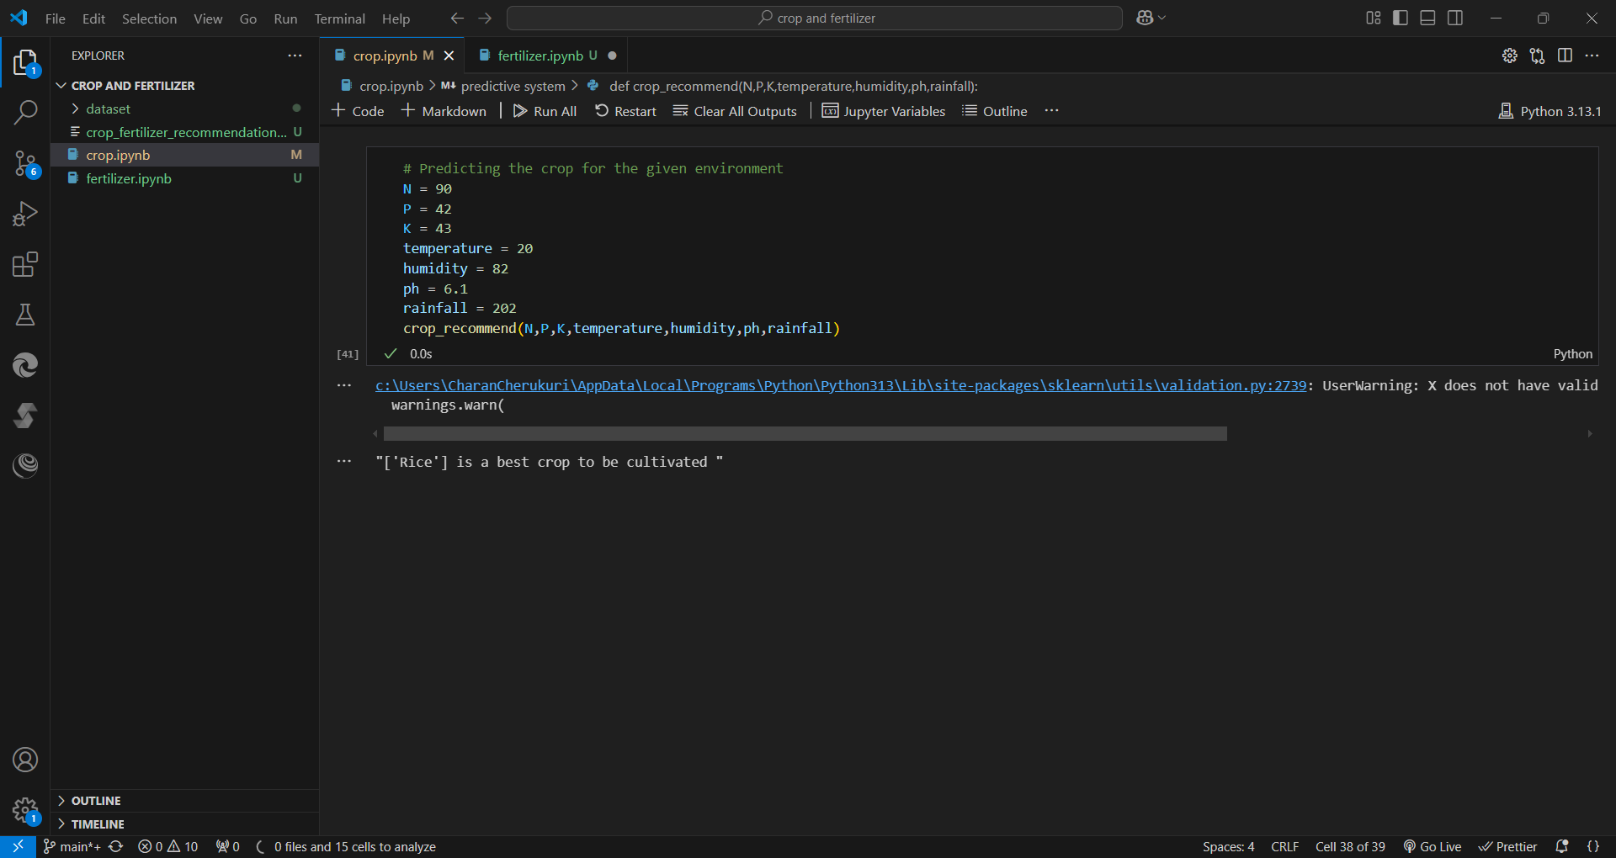
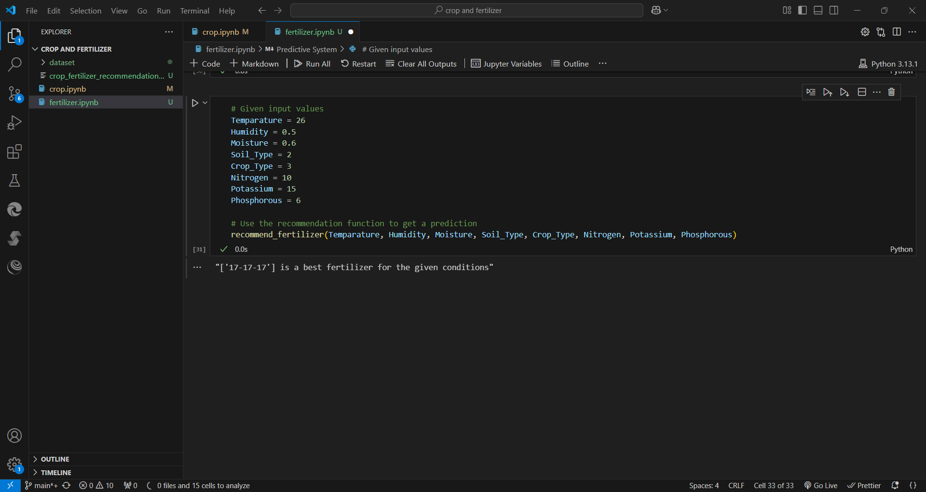
Screenshot of Output:

Slide 8
Conclusion:
Machine Learning can help optimize agricultural practices, improve yield, and reduce resource wastage by recommending optimal crops and fertilizers.

